Slide 1
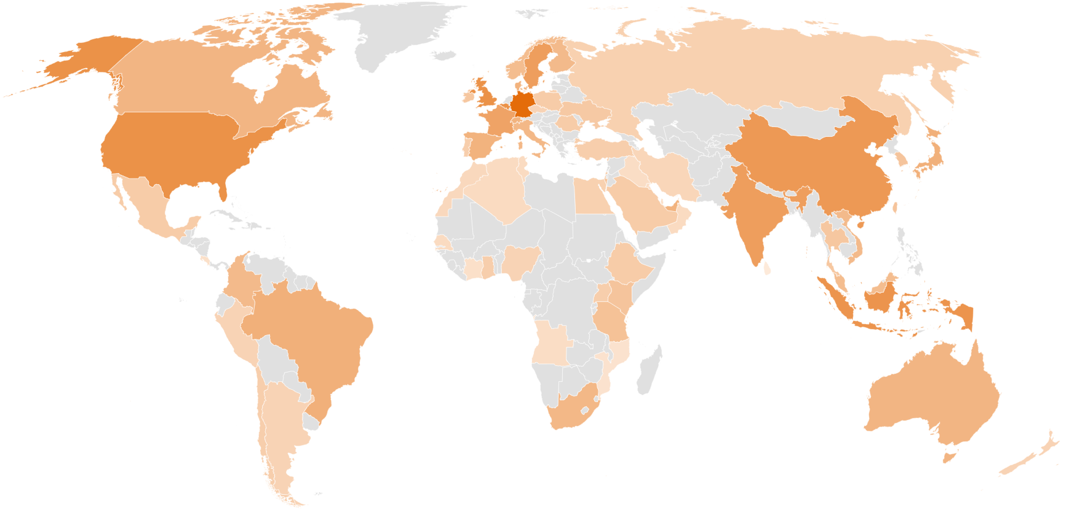
Activities & Support 2021
80 Events
2300 Participants
50 Countries
Public-Private Cooperation
Powered by Health~Holland
Powered by:

Slide 2
Activities & Support
Q1 – Q2 2021: 24 (Public-Private) activities - 680 participants
France | Digital Health mission & matchmaking
Germany |Progam on digitalisation and eHealth – PIB
Germany | DMEA 2021 – PIB
TFHC Europe
TFHC Asia
ASEAN | Seizing new LSH opportunities in South-East Asia - SMM
ASEAN | Digital LSH mission & matchmaking (Indonesia, Thailand, Malaysia, Vietnam, Singapore)
ASEAN - Indonesia| Market Report – SMM
China | Program - Opportunities for collaboration on elderly care
China | Digital kick-off Elderly care
India | Market Report Digital Health
TFHC North America
United States - California | Market Report
TFHC Latin America
Argentina | Market Report
Colombia | Program on Connected Care - PIB
Colombia | Digital incoming delegation Nursing
Colombia |Digital incoming delegation ACEMI Oncology
TFHC Middle East
TFHC
Africa
TFHC Partner meeting March
TFHC Partner meeting May
TFHC Partner meeting July
TFHC Platform meeting Asia
TFHC Platform meeting Middle East
TFHC Platform meeting North America
TFHC International Helpdesk
TFHC International support Start-Ups - SIB
TFHC Tailormade Individual internationalisation support
Kenya | Market Study (Medical Devices & eHealth)

Slide 3
Activities & Support
World of Health Care 2021
409 participants / 45 countries
Q3 – Q4 2021: 20 (Public-Private) activities - 317 participants
Germany |Progam on digitalisation and eHealth – PIB
Germany | eHealth PIB digital mission NRW
Germany | Heallth~Holland Pavilion MEDICA 2021
Denmark, Norway, Sweden | Launch Market Studies
Ukraine | Incoming high-level delegation
TFHC Europe
TFHC Asia
ASEAN | Seizing new LSH opportunities in South-East Asia - SMM
Indonesia | Launch Market Study
Indonesia | Meet & Greet LSH Liasion
China | NDRC collaboration on elderly care
India | Launch market study digital health
TFHC North America
Public-Private LSH Roadmap USA
Canada | LSH Market Study
TFHC North America meeting
TFHC Latin America
TFHC
Africa
TFHC Middle East
Colombia PIB | Program on Connected Care - PIB
TFHC Partner meeting July
TFHC Partner meeting October
TFHC Platform Asia meeting
TFHC Platform Middle East meeting
TFHC International Helpdesk
TFHC International support Start-Ups - SIB
TFHC Tailormade Individual internationalisation support

Slide 4
TFHC Events powered by Health~Holland
Q1 – Q2 2021: 16 events - 625 participants
Digital Country Meet-ups:
Digital Meet-ups:
MDR update on Medical Device Software
How does the MDR affect you?
AI for health - GOING GLOBAL
Maintaining a strong distributor network during the pandemic
How to successfully pitch or present online?
United Kingdom - MedTech post-Brexit
International opportunities for pharma business
Belgium
Brazil
Canada
Central & Eastern Europe (CEE)
Japan
Texas
South Africa
Switzerland
Health~Holland International Strategy 2020-2023
Health~Holland International Monitor
Country factsheets top 20 priority countries

Slide 5
TFHC Events powered by Health~Holland
Q3 – Q4 2021: 17 (Public-Private) activities - 678 participants
Digital Country Meet-ups / Re-Connects:
Digital Meet-ups:
Designing for Healthcare | Health~Holland Digital meet-up
Health Logistics Going Global | Health~Holland Digital meet-up
Sustainable Hospital Build | Health~Holland Digital meet-up
Health~Holland Digital Meet-up Creative Industry
Health~Holland Digital Meet-up Logistics
Health~Holland Europe day
Italy | Health~Holland Digital meet-up
Ukraine | Health~Holland Digital meet-up
India | Health~Holland Digital meet-up
Nordics | Health~Holland Digital Reconnect
Gulf Region | Health~Holland Digital Reconnect
United States (Texas) | Health~Holland Digital Reconnect
United States | Health~Holland Digital Reconnect
ASEAN 5 | Health~Holland Digital Reconnect
Colombia | Health~Holland Digital Reconnect
China | Health~Holland Digital Reconnect
Health~Holland International Strategy 2020-2023
Health~Holland International Monitor
Country factsheets top 20 priority countries
HVP 2021 | 231 participants / 44 countries

